Slide 1
Learning with differentiable and amortized optimization
Brandon Amos • Meta AI (FAIR) NYC
http://github.com/bamos/presentations

Slide 2
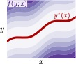




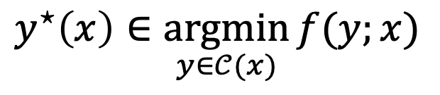
Optimization is crucial technology
Optimization is a modeling and decision-making paradigm and encodes reasoning operations
Finds the best way to interact with a representation of the world
Focus: parametric optimization problems that are repeatedly solved
optimal solution
objective
context (or parameterization)
$$y^{⋆}\left(x\right)∈\underset{y∈𝒞(x)}{argmin}{f(y;x)}$$
optimization variable
constraints
vertical slices are optimization problems
Notes:
Mention context

Slide 3
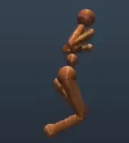
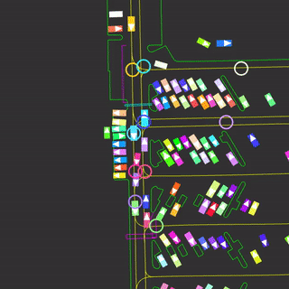
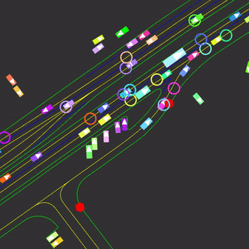
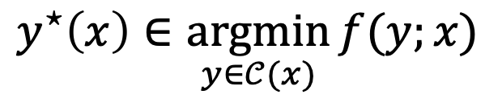
Breakthroughs enabled by optimization include
​controlling systems (robotic, autonomous, mechanical, and multi-agent)
optimal solution
objective
context (or parameterization)
$$y^{⋆}\left(x\right)∈\underset{y∈𝒞(x)}{argmin}{f(y;x)}$$
optimization variable
constraints
Notes:
this talk: not parameter optimization

Slide 4
Breakthroughs enabled by optimization include
​controlling systems (robotic, autonomous, mechanical, and multi-agent)
​​making operational decisions based on future predictions
efficiently transporting or matching resources, information, and measures
​​​allocating budgets and portfolios
​designing materials, molecules, and other structures
​solving inverse problems (to infer underlying hidden costs, incentives, geometries, terrains)
​parameter learning of predictive and statistical models
optimal solution
objective
context (or parameterization)
$$y^{⋆}\left(x\right)∈\underset{y∈𝒞(x)}{argmin}{f(y;x)}$$
optimization variable
constraints
Notes:
this talk: not parameter optimization

Slide 5
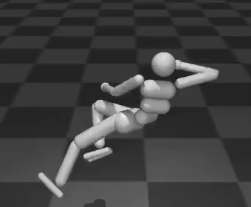
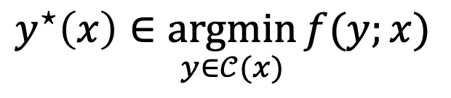
When optimization fails, machine learning helps
$$y^{⋆}\left(x\right)∈\underset{y∈𝒞(x)}{argmin}{f(y;x)}$$
Bad representation of the world (unknown, mis-specified, or inaccurate)
Solving is computationally difficult
When machine learning fails, optimization helps
Optimization provides an internal reasoning operation
A lot of data
Model
Predictions
Loss
Domain knowledge: matrix operations, convolutions, activation functions, transformers, attention mechanisms This talk: optimization-based domain knowledge
Notes:
Optimization starts failing us when:
Analytically encoding every detail into $f$ and $𝒞$ is impossible
May be unknown, mis-specified, or inaccurate
Especially difficult with high-dimensional data (text, images, video)
​Solving for $y^{⋆}\left(x\right)$ is intractable and difficult to compute
Machine learning systems are part of the solution and excel at:
​​​Modeling systems we can extract a lot of data from
Extracting meaningful latent representations
Making fast and accurate predictions

Slide 6
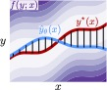
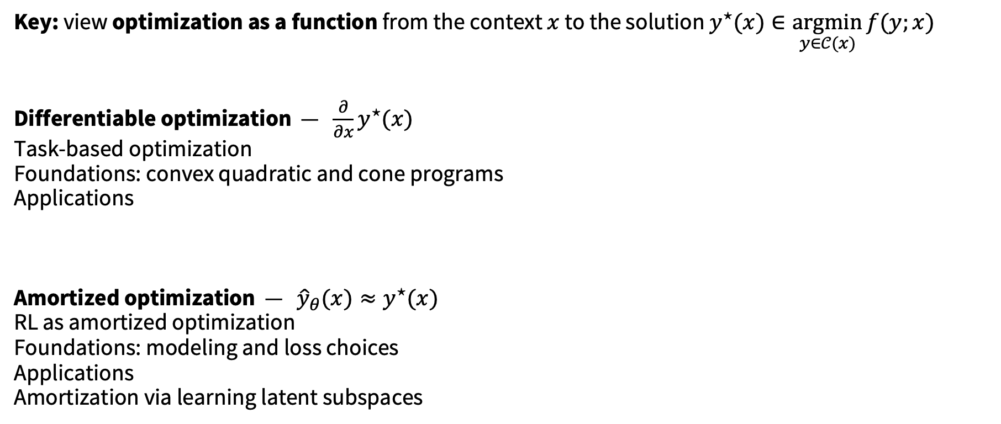
This talk: integrating optimization and learning
Key: view optimization as a function from the context $x$ to the solution $y^{⋆}(x)∈\underset{y∈𝒞(x)}{argmin}{f(y;x)}$
Differentiable optimization — $\frac{∂}{∂x}y^{⋆}(x)$
Task-based optimization
Foundations: convex quadratic and cone programs
Applications
Amortized optimization — ${\hat{y}}_{θ}(x)≈y^{⋆}(x)$
RL as amortized optimization
Foundations: modeling and loss choices
Applications
Amortization via learning latent subspaces

Slide 7
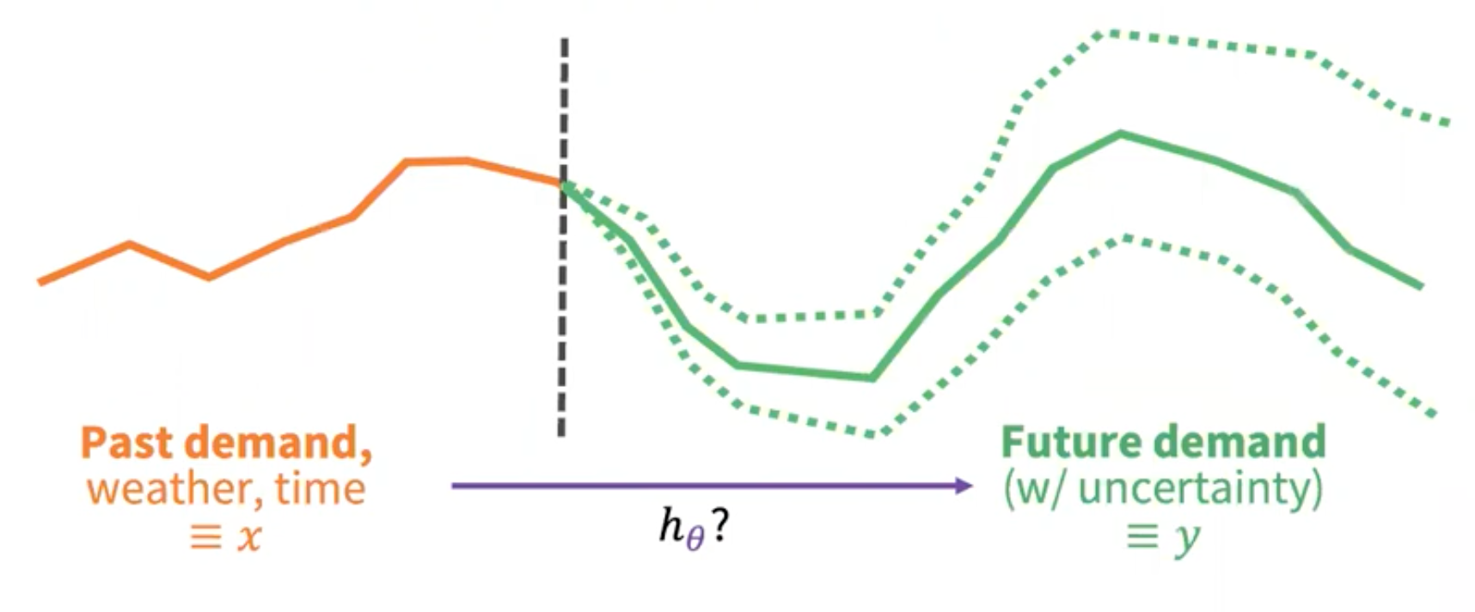


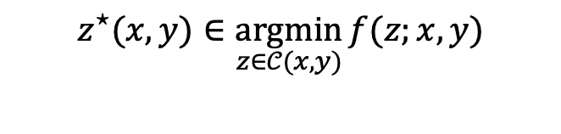
Demand prediction and scheduling
Predicted electricity demands
Electricity generation schedule
$$z^{⋆}(x,y)∈\underset{z∈𝒞(x,y)}{argmin}{f(z;x, y)}$$

Slide 8
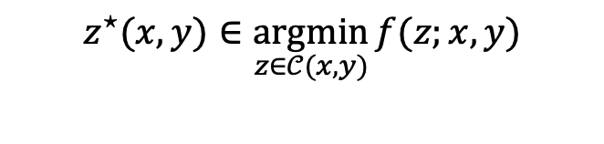
Using predictions for scheduling
Stage 1: maximum likelihood training
A lot of data
Model
Predictions
Loss (log-likelihood)
Stage 2: deploy within a larger system
Query point
Model
Prediction
Downstream task (an optimization problem)
$$z^{⋆}(x,y)∈\underset{z∈𝒞(x,y)}{argmin}{f(z;x, y)}$$

Slide 9

Using predictions for scheduling
Stage 1: maximum likelihood training
A lot of data
Model
Predictions
Loss (log-likelihood)
max-likelihood model $≠$ best model for the task
Why? Modeling errors impact tasks in different ways
Task-based end-to-end model learning in stochastic optimization. Donti, Amos, and Kolter, NeurIPS 2017.
Objective mismatch in model-based reinforcement learning. Lambert, Amos, Yadan, and Calandra, L4DC 2020.
Stage 2: deploy within a larger system
Query point
Model
Prediction
Downstream task (an optimization problem)
$$z^{⋆}(x,y)∈\underset{z∈𝒞(x,y)}{argmin}{f(z;x, y)}$$

Slide 10
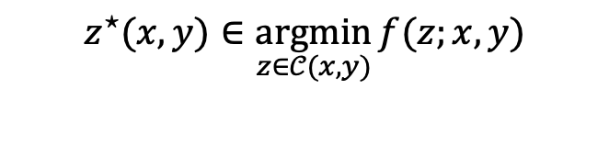
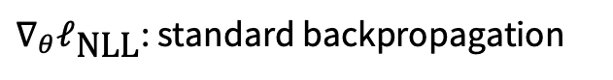
Idea: improve the model with the task loss
Stage 1: maximum likelihood training
A lot of data
Model
Predictions
Loss (log-likelihood)
$∇_{θ}ℓ_{\text{NLL}}$: standard backpropagation
Stage 2: deploy within a larger system. Improve the model with the task information
Query point
Model
Prediction
Downstream task (an optimization problem)
$$z^{⋆}(x,y)∈\underset{z∈𝒞(x,y)}{argmin}{f(z;x, y)}$$
$∇_{θ}ℓ_{\text{task}}$: differentiates through an optimization problem

Slide 11
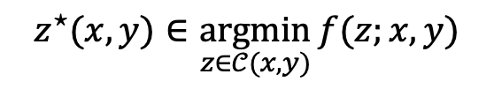
Incorporating the task loss is crucial
Task-based end-to-end model learning in stochastic optimization. Donti, Amos, and Kolter, NeurIPS 2017.
negative log-likelihood
task-based generation loss
train with maximum likelihood
+ task loss
hour of day
hour of day
$$z^{⋆}(x,y)∈\underset{z∈𝒞(x,y)}{argmin}{f(z;x, y)}$$

Slide 12
How to differentiate an optimization problem?
$∇_{θ}ℓ_{\text{task}}$: differentiates through an optimization problem
???

Slide 13
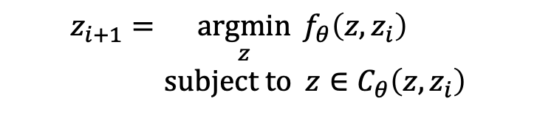
Differentiable optimization layers
Definition. A differentiable optimization layer for a machine learning model internally solves an optimization problem and is learned with backpropagation
A lot of data
Model
Predictions
Loss
…
Optimization Layer
…
$$z_{i+1}=\underset{z}{argmin}{f_{θ}\left(z, z_{i}\right)} \\ subject to z∈C_{θ}\left(z, z_{i}\right)$$
Notes:
Why optimization? Many useful operations can be expressed with optimization (sorting, permutations, top-k, control, planning, power generation)
Why differentiable optimization? End-to-end learn through the optimization procedure along with the other parts of the model using derivatives

Slide 14
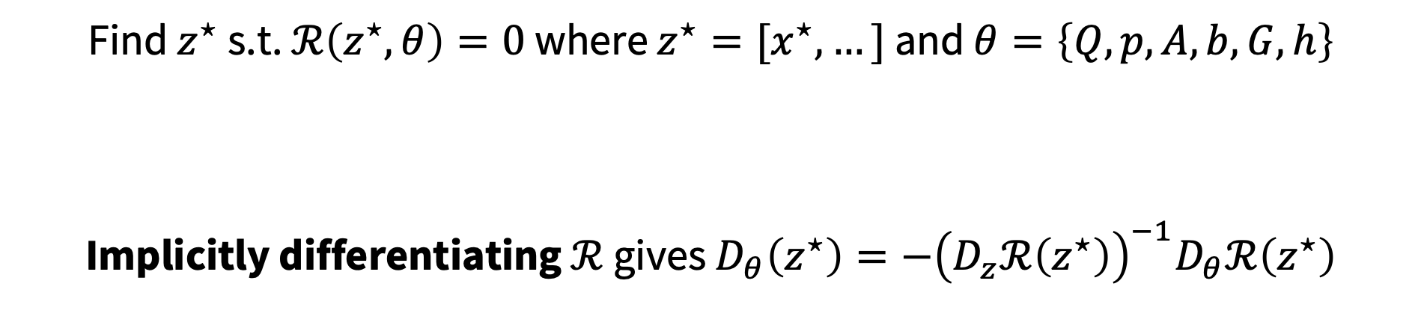
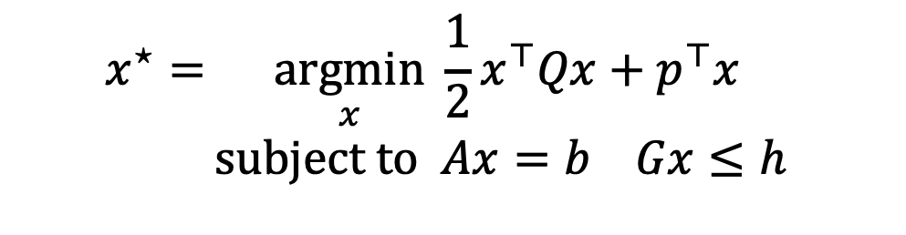
Differentiable convex quadratic programs
OptNet: Differentiable Optimization as a Layer in Neural Networks. Amos and Kolter, ICML 2017.
$$x^{⋆}=\underset{x}{argmin}{\frac{1}{2}x^{⊤}Qx+p^{⊤}x} \\ subject to Ax=b Gx≤h$$
KKT Optimality
Find $z^{⋆}$ s.t. $ℛ\left(z^{⋆}, θ\right)=0$ where $z^{⋆}=[x^{⋆},…]$ and $θ=\left\{Q,p,A,b,G,h\right\}$
Implicitly differentiating $ℛ$ gives $D_{θ}\left(z^{⋆}\right)=−{\left(D_{z}ℛ\left(z^{⋆}\right)\right)}^{−1}D_{θ}ℛ\left(z^{⋆}\right)$

Slide 15
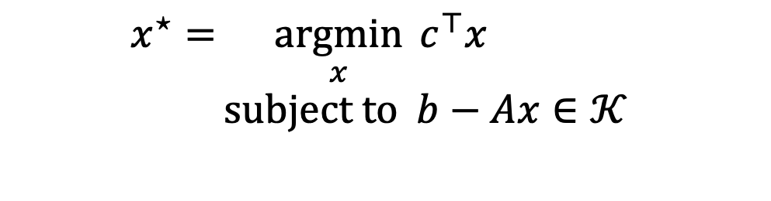
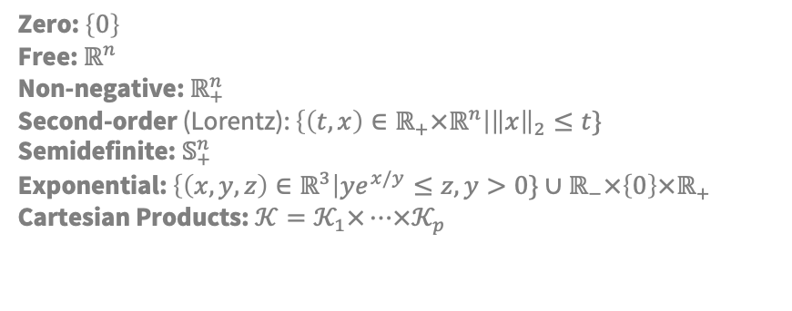
Differentiable convex conic programs
Section 7 of Differentiable optimization-based modeling for machine learning. Amos, PhD Thesis 2019
Differentiating through a cone program. Agrawal et al., 2019 Differentiable convex optimization layers. Agrawal*, Amos*, Barratt*, Boyd*, Diamond*, Kolter*, NeurIPS 2019.
$$x^{⋆}=\underset{x}{argmin}{c^{⊤}x} \\ subject to b−Ax∈𝒦$$
Zero: $\left\{0\right\}$ Free: $ℝ^{n}$ Non-negative: $ℝ_{+}^{n}$ Second-order (Lorentz): $\left\{\left(t,x\right)∈ℝ_{+}×ℝ^{n}\right|{\left\|x\right\|}_{2}≤t\}$ Semidefinite: $𝕊_{+}^{n}$ Exponential: $\left\{\left(x,y,z\right)∈ℝ^{3}\right|ye^{x/y}≤z, y>0\}∪ℝ_{−}×\left\{0\right\}×ℝ_{+}$ Cartesian Products: $𝒦=𝒦_{1}×…×𝒦_{p}$
Conic Optimality
Find $z^{⋆}$ s.t. $ℛ\left(z^{⋆}, θ\right)=0$ where $z^{⋆}=[x^{⋆},…]$ and $θ=\{A,b,c\}$
Implicitly differentiating $ℛ$ gives $D_{θ}\left(z^{⋆}\right)=−{\left(D_{z}ℛ\left(z^{⋆}\right)\right)}^{−1}D_{θ}ℛ\left(z^{⋆}\right)$
Notes:
Handle cone constraints in optimality

Slide 16
Applications of differentiable optimization
Task-based end-to-end model learning in stochastic optimization. Donti, Amos, and Kolter, NeurIPS 2017.
Task-based learning (task-aware predictions, decision-focused learning)

Slide 17


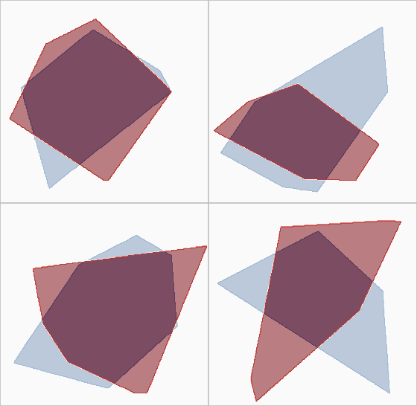
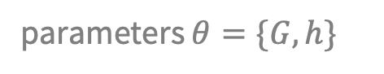
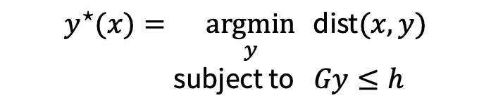
Applications of differentiable optimization
OptNet: Differentiable Optimization as a Layer in Neural Networks. Amos and Kolter, ICML 2017.
Task-based learning (task-aware predictions, decision-focused learning)
Learning hard constraints (Sudoku from data)
true polytope (unknown to the model)
polytope predictions during training
example 1
example 2
$$y^{⋆}(x)=\underset{y}{argmin}{ \text{dist}(x,y)} \\ \text{subject} \text{to} Gy≤h$$
parameters $θ=\{G,h\}$
example 3
example 4

Slide 18
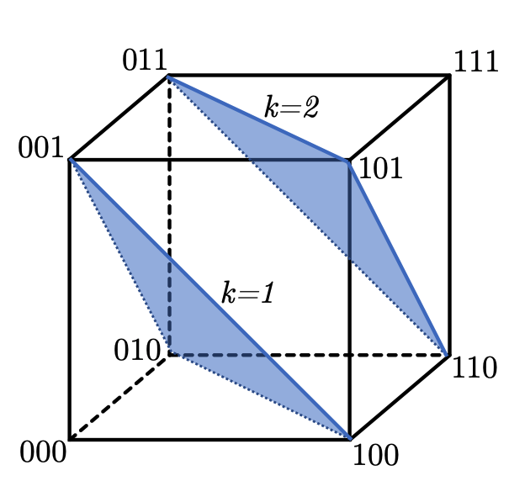
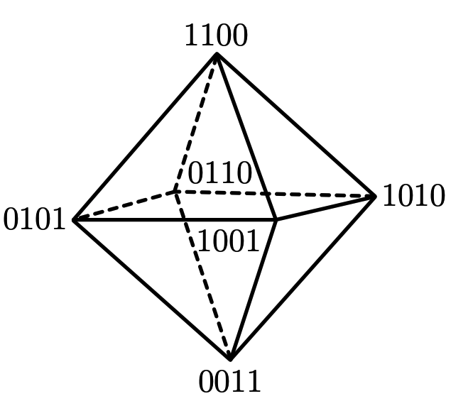
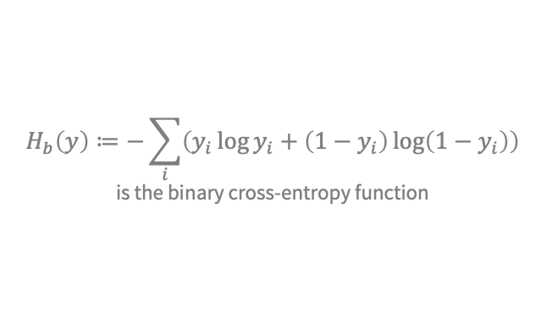
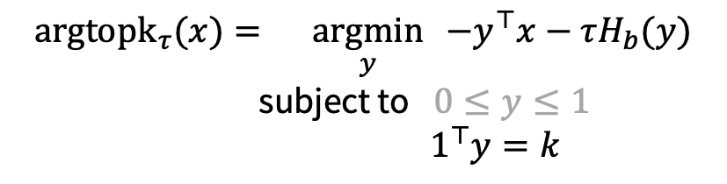
Applications of differentiable optimization
Limited multi-label projection layer. Amos et al., 2019.
Task-based learning (task-aware predictions, decision-focused learning)
Learning hard constraints (Sudoku from data)
Modeling projections (ReLU, sigmoid, softmax; differentiable top-k, and sorting)
$${\text{argtopk}}_{τ}(x)=\underset{y}{argmin}{ −y^{⊤}x−τH_{b}(y)} \\ \text{subject} \text{to} 0≤y≤1$$
$$1^{⊤}y=k$$
$$H_{b}\left(y\right)≔−\sum_{i}{\left(y_{i}\log{y_{i}}+\left(1−y_{i}\right)\log\left(1−y_{i}\right)\right)}$$ is the binary cross-entropy function

Slide 19
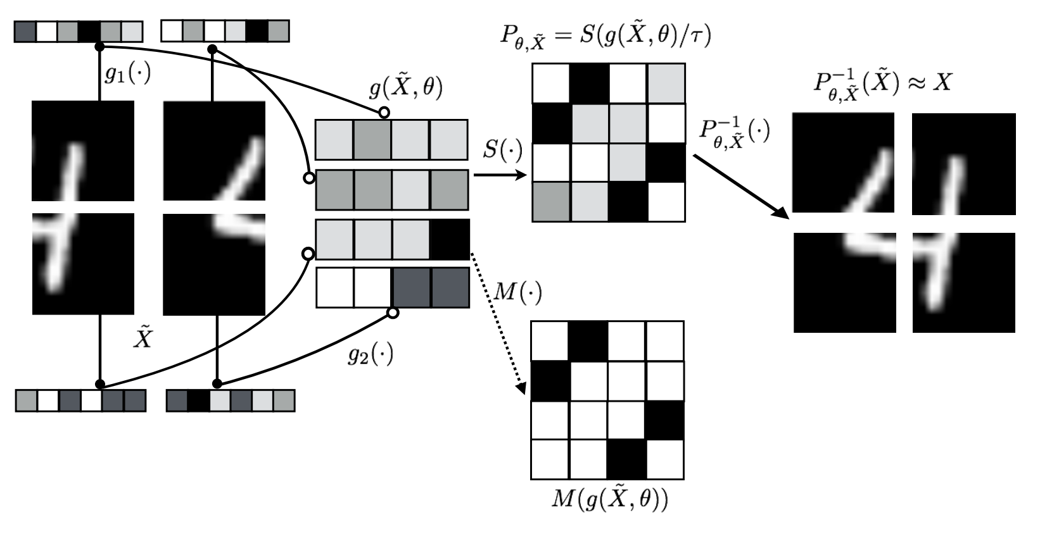
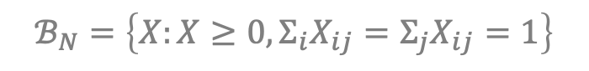
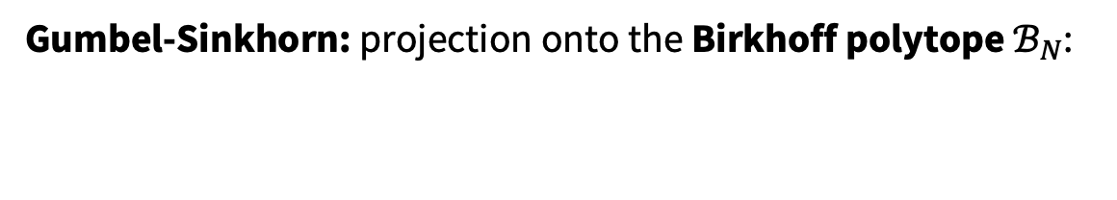
Applications of differentiable optimization
Learning latent permutations with Gumbel-Sinkhorn networks. Mena et al., ICLR 2018.
Task-based learning (task-aware predictions, decision-focused learning)
Learning hard constraints (Sudoku from data)
Modeling projections (ReLU, sigmoid, softmax; differentiable top-k, and sorting)
Gumbel-Sinkhorn: projection onto the Birkhoff polytope $ℬ_{N}$:
$$π_{ℬ_{N},τ}(X)=\underset{P∈ℬ_{N}}{argmax}{{ \left\langle P, X\right\rangle }_{F}+τH\left(P\right)}$$
$$ℬ_{N}=\left\{X:X≥0, Σ_{i}X_{ij}=Σ_{j}X_{ij}=1\right\}$$

Slide 20


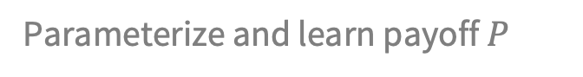
Applications of differentiable optimization
What Game Are We Playing? End-to-end Learning in Normal and Extensive Form Games. Ling et al., IJCAI 2018.
Task-based learning (task-aware predictions, decision-focused learning)
Learning hard constraints (Sudoku from data)
Modeling projections (ReLU, sigmoid, softmax; differentiable top-k, and sorting)
Game theory (differentiable equilibrium finding)
$$\min_{u}{\max_{v}{u^{⊤}Pv} \text{subject} \text{to} { 1}^{⊤}u=1 1^{⊤}v=1 u,v≥0 }$$
Parameterize and learn payoff $P$

Slide 21
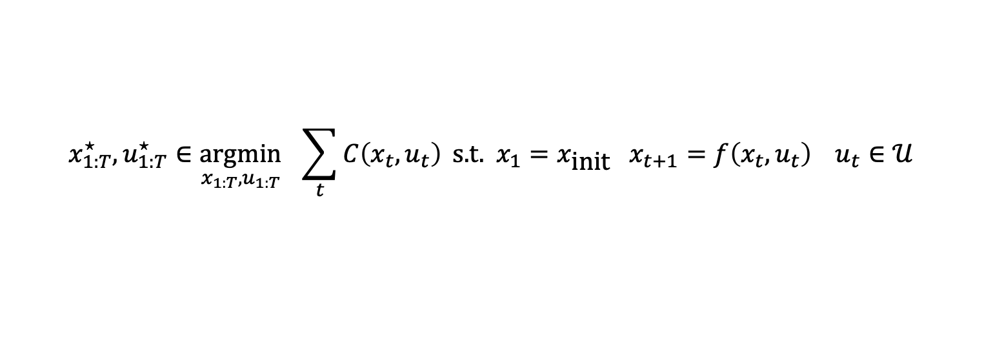
Applications of differentiable optimization
Differentiable MPC for end-to-end planning and control. Amos et al., NeurIPS 2018. The differentiable cross-entropy method. Amos and Yarats, ICML 2020.
Task-based learning (task-aware predictions, decision-focused learning)
Learning hard constraints (Sudoku from data)
Modeling projections (ReLU, sigmoid, softmax; differentiable top-k, and sorting)
Game theory (differentiable equilibrium finding)
RL and control (differentiable control-based policies, enforcing safety constraints)
cost
initial state
dynamics
constraints
$${x_{1:T}^{⋆}, u}_{1:T}^{⋆}∈\underset{{x_{1:T}, u}_{1:T}}{argmin}{ \sum_{t}{C\left(x_{t}, u_{t}\right)}} \text{s}\text{.}\text{t}\text{. }x_{1}=x_{\text{init}} x_{t+1}=f\left(x_{t}, u_{t}\right) u_{t}∈𝒰$$
Parameterize and learn cost and dynamics

Slide 22
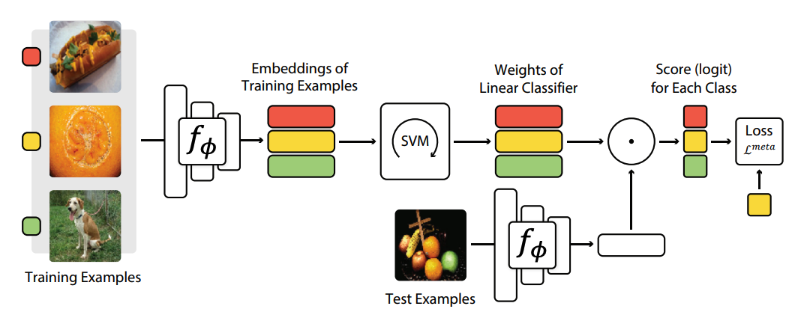
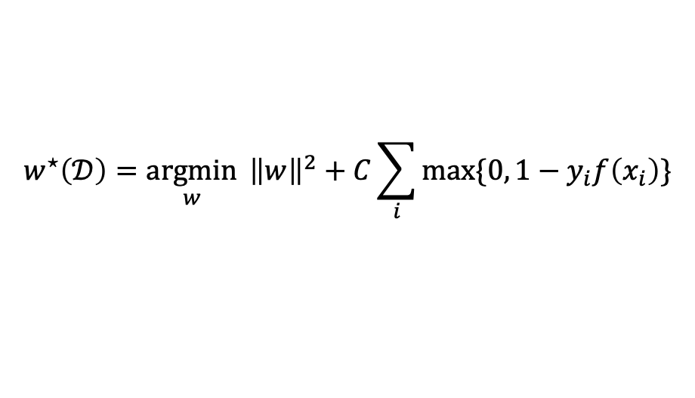
Applications of differentiable optimization
Meta-learning with differentiable convex optimization. Lee et al., CVPR 2019.
Task-based learning (task-aware predictions, decision-focused learning)
Learning hard constraints (Sudoku from data)
Modeling projections (ReLU, sigmoid, softmax; differentiable top-k, and sorting)
Game theory (differentiable equilibrium finding)
RL and control (differentiable control-based policies, enforcing safety constraints)
Meta-learning (differentiable SVMs and optimizers, implicit MAML)
MetaOptNet: Differentiate the decision boundary w.r.t. the dataset
$$w^{⋆}\left(𝒟\right)={\underset{w}{argmin}{ \left\|w\right\|}}^{2}+C\sum_{i}{\max{\{0, 1−y_{i}f\left(x_{i}\right)\}}}$$

Slide 23
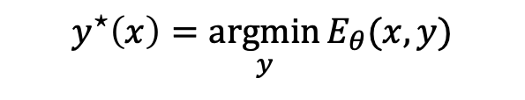
Applications of differentiable optimization
Input-convex neural networks. Amos, Xu, Kolter, ICML 2017.
Task-based learning (task-aware predictions, decision-focused learning)
Learning hard constraints (Sudoku from data)
Modeling projections (ReLU, sigmoid, softmax; differentiable top-k, and sorting)
Game theory (differentiable equilibrium finding)
RL and control (differentiable control-based policies, enforcing safety constraints)
Meta-learning (differentiable SVMs and optimizers, implicit MAML)
Energy-based learning and structured prediction (differentiable inference with, e.g., ICNNs)
$$y^{⋆}\left(x\right)=\underset{y}{argmin}{E_{θ}(x,y)}$$

Slide 24
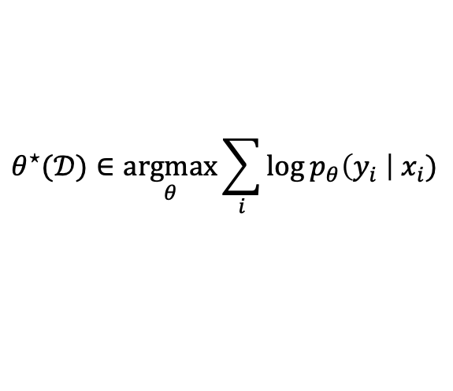
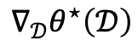
Applications of differentiable optimization
Differentiable convex optimization layers. Agrawal*, Amos*, Barratt*, Boyd*, Diamond*, Kolter*, NeurIPS 2019.
Task-based learning (task-aware predictions, decision-focused learning)
Learning hard constraints (Sudoku from data)
Modeling projections (ReLU, sigmoid, softmax; differentiable top-k, and sorting)
Game theory (differentiable equilibrium finding)
RL and control (differentiable control-based policies, enforcing safety constraints)
Meta-learning (differentiable SVMs and optimizers, implicit MAML)
Energy-based learning and structured prediction (differentiable inference with, e.g., ICNNs)
Sensitivity analysis (differentiable logistic regression)
$$∇_{𝒟}θ^{⋆}\left(𝒟\right)$$
$$θ^{⋆}(𝒟)∈\underset{θ}{argmax}{\sum_{i}{\log{p_{θ}\left(y_{i} \right|{ x}_{i})}}}$$

Slide 25
Applications of differentiable optimization
Task-based learning (task-aware predictions, decision-focused learning)
Learning hard constraints (Sudoku from data)
Modeling projections (ReLU, sigmoid, softmax; differentiable top-k, and sorting)
Game theory (differentiable equilibrium finding)
RL and control (differentiable control-based policies, enforcing safety constraints)
Meta-learning (differentiable SVMs and optimizers, implicit MAML)
Energy-based learning and structured prediction (differentiable inference with, e.g., ICNNs)
Sensitivity analysis (differentiable logistic regression)

Slide 26
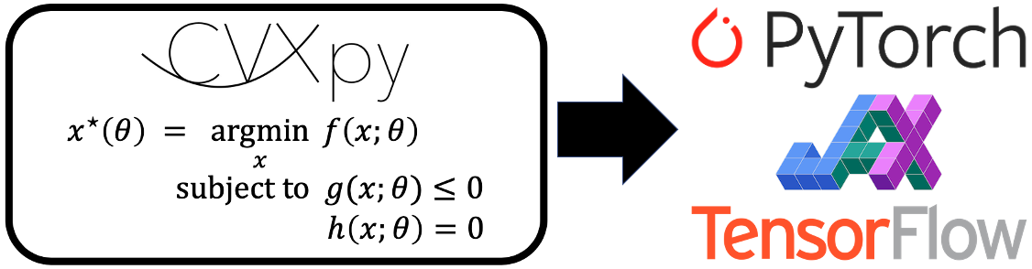
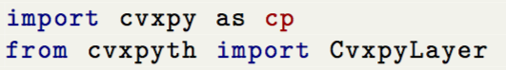
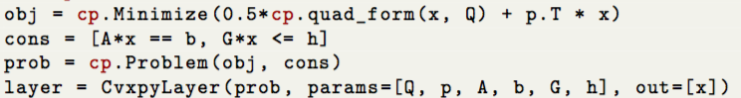
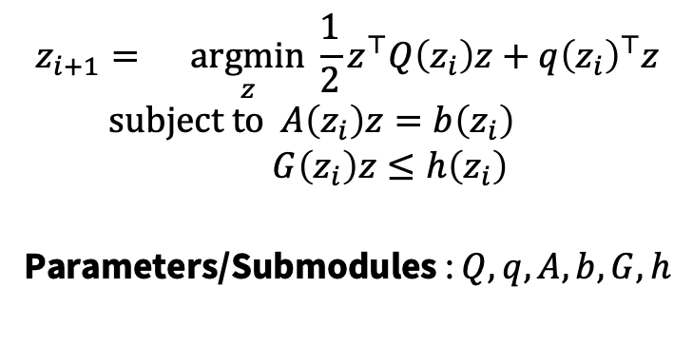
Differentiable CVXPY layers
Differentiable convex optimization layers. Agrawal*, Amos*, Barratt*, Boyd*, Diamond*, Kolter*, NeurIPS 2019.
(Officially part of CVXPY!)
$$z_{i+1}=\underset{z}{argmin}{\frac{1}{2}z^{⊤}Q\left(z_{i}\right)z+q{\left(z_{i}\right)}^{⊤}z} \\ subject to A\left(z_{i}\right)z=b\left(z_{i}\right) \\ G\left(z_{i}\right)z≤h\left(z_{i}\right)$$
Parameters/Submodules : $Q,q,A,b,G,h$
Before: 1k lines of code, now:

Slide 27
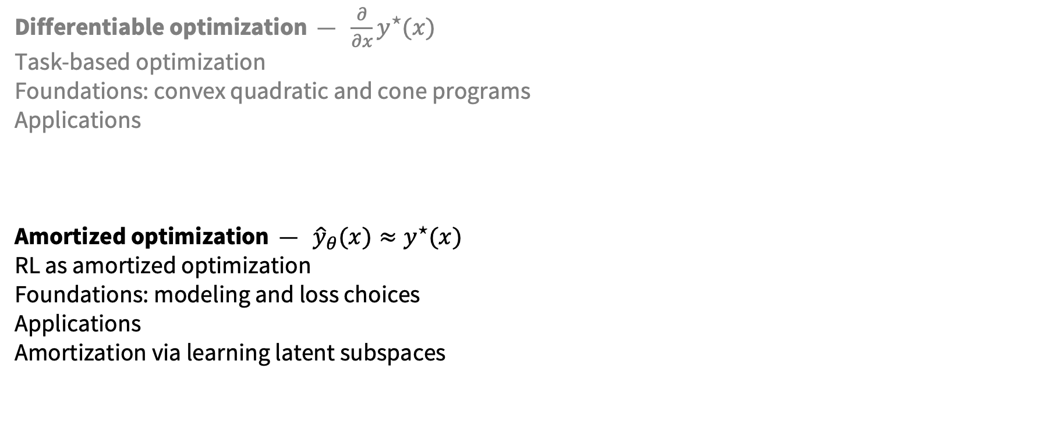
This talk
Differentiable optimization — $\frac{∂}{∂x}y^{⋆}(x)$
Task-based optimization
Foundations: convex quadratic and cone programs
Applications
Amortized optimization — ${\hat{y}}_{θ}(x)≈y^{⋆}(x)$
RL as amortized optimization
Foundations: modeling and loss choices
Applications
Amortization via learning latent subspaces

Slide 28
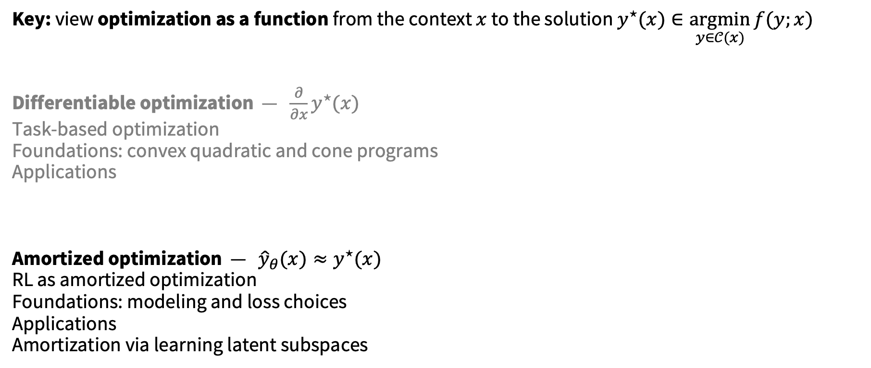
This talk: integrating optimization and learning
Key: view optimization as a function from the context $x$ to the solution $y^{⋆}(x)∈\underset{y∈𝒞(x)}{argmin}{f(y;x)}$
Differentiable optimization — $\frac{∂}{∂x}y^{⋆}(x)$
Task-based optimization
Foundations: convex quadratic and cone programs
Applications
Amortized optimization — ${\hat{y}}_{θ}(x)≈y^{⋆}(x)$
RL as amortized optimization
Foundations: modeling and loss choices
Applications
Amortization via learning latent subspaces

Slide 29
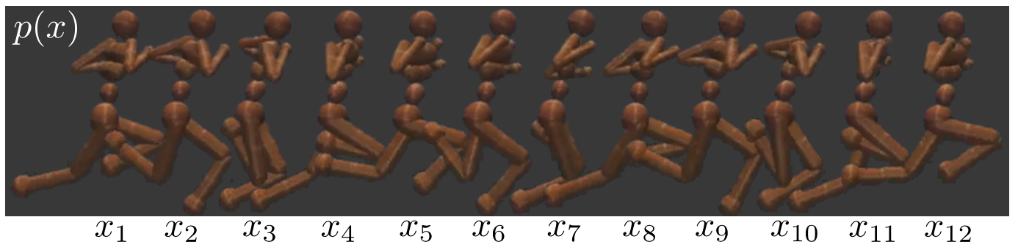
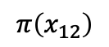
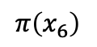
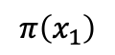
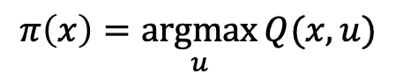
Deploying optimization and repeated solves
Tutorial on amortized optimization for learning to optimize over continuous domains. Amos, Foundations and Trends in Machine Learning 2023.
On the model-based stochastic value gradient for continuous reinforcement learning. Amos et al., L4DC 2021.
$$π\left(x_{1}\right)$$
$$π\left(x_{6}\right)$$
$$π\left(x_{12}\right)$$
value
action
action
action
$$π\left(x\right)=\underset{u}{argmax}{Q(x,u)}$$

Slide 30
Repeatedly solved problems share structure
Tutorial on amortized optimization for learning to optimize over continuous domains. Amos, Foundations and Trends in Machine Learning 2023.

Slide 31
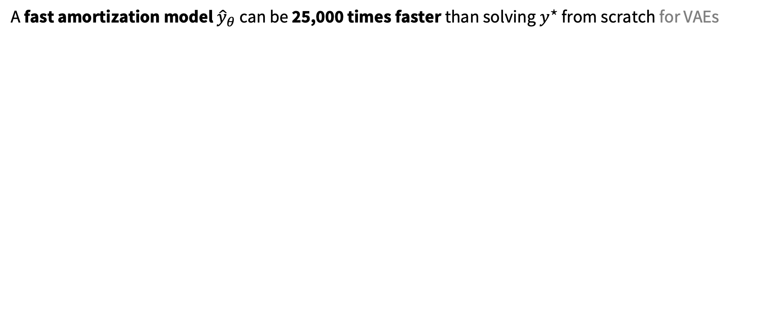

Amortization: approximate the solution map
Tutorial on amortized optimization for learning to optimize over continuous domains. Amos, Foundations and Trends in Machine Learning 2023.
A fast amortization model ${\hat{y}}_{θ}$ can be 25,000 times faster than solving $y^{⋆}$ from scratch for VAEs
Amortization model ${\hat{y}}_{θ}(x)$ tries to approximate $y^{⋆}\left(x\right)$
Example: A neural network mapping from $x$ to the solution
Loss $ℒ$ measures how well $\hat{y}$ fits $y^{⋆}$ and optimized with $\min_{θ} ℒ\left({\hat{y}}_{θ}\right)$
Regression: $ℒ\left({\hat{y}}_{θ}\right)≔𝔼_{p\left(x\right)} {\left\|{\hat{y}}_{θ}\left(x\right)−y^{⋆}\left(x\right)\right\|}_{2}^{2}$
Objective: $ℒ\left({\hat{y}}_{θ}\right)≔𝔼_{p\left(x\right)}f({\hat{y}}_{θ}\left(x\right))$

Slide 32
Applications of amortized optimization
Tutorial on amortized optimization for learning to optimize over continuous domains. Amos, Foundations and Trends in Machine Learning 2023.
Reinforcement learning and control (actor-critic methods, SAC, DDPG, GPS, BC)

Slide 33








Applications of amortized optimization
Tutorial on amortized optimization for learning to optimize over continuous domains. Amos, Foundations and Trends in Machine Learning 2023.
Reinforcement learning and control (actor-critic methods, SAC, DDPG, GPS, BC)
Variational inference (VAEs, semi-amortized VAEs)
Given a VAE model $p\left(x\right)=\log{\int_{z}{p\left(x | z\right)p(x)}}$, encoding amortizes the optimization problem
$λ^{⋆}\left(x\right)=\underset{λ}{argmax}{\text{ELBO}(λ;x)}$ where $\text{ELBO}\left(λ;x\right)≔𝔼_{q\left(z;λ\right)}\left[\log{p(x|z})\right]−{\text{D}}_{\text{KL}}\left(q\left(x;λ\right)\right|p(z)).$
$$x_{1}$$
$$x_{2}$$
$$x_{3}$$
$$λ$$

Slide 34

Applications of amortized optimization
Tutorial on amortized optimization for learning to optimize over continuous domains. Amos, Foundations and Trends in Machine Learning 2023.
Reinforcement learning and control (actor-critic methods, SAC, DDPG, GPS, BC)
Variational inference (VAEs, semi-amortized VAEs)
Meta-learning (HyperNets, MAML)
Given a task $𝒯$, amortize the computation of the optimal parameters of a model
$$θ^{⋆}\left(𝒯\right)=\underset{θ}{argmax}{ℓ(𝒯, θ)}$$

Slide 35

Applications of amortized optimization
Tutorial on amortized optimization for learning to optimize over continuous domains. Amos, Foundations and Trends in Machine Learning 2023.
Reinforcement learning and control (actor-critic methods, SAC, DDPG, GPS, BC)
Variational inference (VAEs, semi-amortized VAEs)
Meta-learning (HyperNets, MAML)
Sparse coding (PSD, LISTA)
Given a dictionary $W_{d}$ of basis vectors and input $x$, a sparse code is recovered with
$$y^{⋆}\left(x\right)∈\underset{y}{argmin}{{\left\|x−W_{d}y\right\|}_{2}^{2}+α{\left\|y\right\|}_{1}}$$
Predictive sparse decomposition (PSD) and Learned ISTA (LISTA) amortize this problem
Kavukcuoglu, Ranzato, and LeCun, 2010.
Gregor and LeCun, 2010.

Slide 36




Applications of amortized optimization
Tutorial on amortized optimization for learning to optimize over continuous domains. Amos, Foundations and Trends in Machine Learning 2023.
Reinforcement learning and control (actor-critic methods, SAC, DDPG, GPS, BC)
Variational inference (VAEs, semi-amortized VAEs)
Meta-learning (HyperNets, MAML)
Sparse coding (PSD, LISTA)
Roots, fixed points, and convex optimization (NeuralDEQs, RLQP, NeuralSCS)
$$x^{⋆}=\underset{x}{argmin}{{\frac{1}{2}x^{⊤}Qx+p}^{⊤}x} \\ subject to b−Ax∈𝒦$$
Finding fixed points $y=g\left(y\right)$
KKT conditions
Find $z^{⋆}$ s.t. $ℛ\left(z^{⋆}, θ\right)=0$

Slide 37

Applications of amortized optimization
Tutorial on amortized optimization for learning to optimize over continuous domains. Amos, Foundations and Trends in Machine Learning 2023.
Reinforcement learning and control (actor-critic methods, SAC, DDPG, GPS, BC)
Variational inference (VAEs, semi-amortized VAEs)
Meta-learning (HyperNets, MAML)
Sparse coding (PSD, LISTA)
Roots, fixed points, and convex optimization (NeuralDEQs, RLQP, NeuralSCS)
Optimal transport (slicing, conjugation, Meta Optimal Transport)
$${T^{⋆}(α, β)∈\underset{T∈𝒞\left(α, β\right)}{argmin}{𝔼_{x∼α}\left\|x−T\left(x\right)\right\|}}_{2}^{2}$$
Meta Optimal Transport. Amos et al., 2022

Slide 38





Applications of amortized optimization
Tutorial on amortized optimization for learning to optimize over continuous domains. Amos, Foundations and Trends in Machine Learning 2023.
Reinforcement learning and control (actor-critic methods, SAC, DDPG, GPS, BC)
Variational inference (VAEs, semi-amortized VAEs)
Meta-learning (HyperNets, MAML)
Sparse coding (PSD, LISTA)
Roots, fixed points, and convex optimization (NeuralDEQs, RLQP, NeuralSCS)
Optimal transport (slicing, conjugation, Meta Optimal Transport)
$$f^{c}\left(y\right)=−\inf_{x}{f\left(x\right)−x^{⊤}y}$$
On amortizing convex conjugates for optimal transport. Amos, ICLR 2023

Slide 39

Applications of amortized optimization
Reinforcement learning and control (actor-critic methods, SAC, DDPG, GPS, BC)
Variational inference (VAEs, semi-amortized VAEs)
Meta-learning (HyperNets, MAML)
Sparse coding (PSD, LISTA)
Roots, fixed points, and convex optimization (NeuralDEQs, RLQP, NeuralSCS)
Optimal transport (slicing, conjugation, Meta Optimal Transport)
Foundations and Trends® in Machine Learning

Slide 40


Amortization via learning latent subspaces
The differentiable cross-entropy method. Amos and Yarats, ICML 2020.
Full control sequence space
Amortize the problem by learning a latent subspace of optimal solutions
Only search over optimal solutions rather than the entire space
cost
initial state
dynamics
constraints
$${x_{1:T}^{⋆}, u}_{1:T}^{⋆}∈\underset{{x_{1:T}, u}_{1:T}}{argmin}{ \sum_{t}{C_{θ}\left(x_{t}, u_{t}\right)}} \text{s}\text{.}\text{t}\text{. }x_{1}=x_{\text{init}} x_{t+1}=f_{θ}\left(x_{t}, u_{t}\right) u_{t}∈𝒰$$
Subspace of optimal solutions
Cartpole videos
Optimal controls over time — force on the cartpole
Time

Slide 41


Amortization via learning latent subspaces
The differentiable cross-entropy method. Amos and Yarats, ICML 2020.
$$u^{⋆}=\underset{u∈{\left[0,1\right]}^{N}}{argmin}{f\left(u\right)}$$
Full control sequence space
Subspace of optimal solutions
Latent space of optimal solutions

Slide 42
Future directions and open questions
Goal: build intelligent systems that understand and interact with the world Why? To advance scientific and engineering discoveries Advancing optimization and machine learning foundations is crucial
differentiable optimization
amortized optimization

Slide 43





How to handle discrete spaces?
CombOptNet. Paulus, Rolínek, Musil, Amos, and Martius, ICML 2021.
optimal solution
objective
context (or parameterization)
$$y^{⋆}\left(x\right)∈\underset{y∈𝒞(x)}{argmin}{f(y;x)}$$
optimization variable
constraints
knapsack problems
scheduling/assignment problems
continuous
discrete
keypoint matching

Slide 44

How to transfer knowledge between structures?
Cross-domain imitation learning via optimal transport. Fickinger, Cohen, Russell, Amos, ICLR 2022.
Optimization (optimal transport) connects disparate spaces to enable knowledge transfer
expert (3 dimensions)
new system (5 dimensions)
expert
new system
Notes:
agents -> structure

Slide 45

How can latent representations gain an awareness of unobserved concepts?
Learning awareness models. Amos et al., ICLR 2018.
Situation awareness is the perception of the elements in the environment within a volume of time and space, and the comprehension of their meaning, and the projection of their status in the near future. — Mica Endsley (1987) Former Chief Scientist of the U.S. Air Force

Slide 46


How to model and control non-trivial systems?
Nocturne: a driving benchmark for multi-agent learning. Vinitsky et al., NeurIPS Datasets and Benchmarks 2022
On the model-based stochastic value gradient for continuous reinforcement. B. Amos et al., L4DC 2021.
Learning Neural Event Functions for Ordinary Differential Equations.
Chen, Amos, Nickel, ICLR 2021.
Notes:
TODO: safety/generalization

Slide 47

How to perform machine learning and optimization over non-Euclidean spaces?
Riemannian convex potential maps. Cohen*, Amos*, and Lipman, ICML 2021.
Base distribution
$c$-convex function
Grid warped by the transport
Push-forward distribution
Earth 90 million years ago
Earth today
Optimal transport displacement

Slide 48
How to perform machine learning and optimization over non-Euclidean spaces?
Matching Normalizing Flows and Probability Paths on Manifolds. Ben-Hamu et al., ICML 2022.

Slide 49
Summary
Optimization expresses non-trivial reasoning operations
Integrates nicely with machine learning by seeing it as a function
differentiable optimization
amortized optimization

Slide 50

Learning with differentiable and amortized optimization
Brandon Amos • Meta AI (FAIR) NYC
http://github.com/bamos/presentations
[ICML 2017] Differentiable QPs: OptNet
[ICML 2017] Input-convex neural networks
[NeurIPS 2017] Differentiable Task-based Model Learning
[NeurIPS 2018] Differentiable MPC for End-to-end Planning and Control
[ICLR 2018] Learning Awareness Models
[NeurIPS 2019] Differentiable Convex Optimization Layers
[Ph.D. Thesis 2019] Differentiable Optimization-Based Modeling for ML
[arXiv 2019] Differentiable Top-k and Multi-Label Projection
[arXiv 2019] Generalized Inner Loop Meta-Learning: $∇$higher
[ICML 2020] Differentiable Cross-Entropy Method
[L4DC 2020] Objective Mismatch in MBRL
[MLCB 2020] Neural Potts Model
[ICML 2021] Differentiable Combinatorial Optimization: CombOptNet
[AISTATS 2021] Gromov-DTW time series alignment
[ICML 2021] Riemannian Convex Potential Maps
[L4DC 2021] On the model-based stochastic value gradient
[ICLR 2021] Learning Neural Event Functions for ODEs
[ICLR 2021] Neural Spatio-Temporal Point Processes
[NeurIPS 2021] Online planning via RL amortization
[ICML 2022] Matching Flows and Probability Paths on Manifolds
[NeurIPS 2022] Theseus: Differentiable Nonlinear Optimization
[NeurIPS 2022] Differentiable Voronoi tessellation
[NeurIPS 2022] Nocturne self-driving benchmark
[ICLR 2022] Cross-Domain Imitation Learning via Optimal Transport
[arXiv 2022] Meta Optimal Transport
[ICLR 2023] On amortizing convex conjugates for optimal transport
[L4DC 2023] End-to-End Learning to Warm-Start for QPs
[Foundations and Trends in ML 2023] Tutorial on amortized optimization
Collaborators: Akshay Agrawal, Andrew Gordon Wilson, Anselm Paulus, Arnaud Fickinger, Byron Boots, Denis Yarats, Edward Grefenstette, Eugene Vinitsky, Franziska Meier, Georg Martius, Giulia Luise, Heli Ben-Hamu, Hengyuan Hu, Ievgen Redko, Ivan Jimenez, Jacob Sacks, Jakob Foerster, Joseph Ortiz, Laurent Dinh, Luis Pineda, Marc Deisenroth, Maximilian Nickel, Michal Rolínek, Mikael Henaff, Misha Denil, Mustafa Mukadam, Nando de Freitas, Nathan Lambert, Noam Brown, Omry Yadan, Priya Donti, Ricky Chen, Roberto Calandra, Samuel Cohen, Samuel Stanton, Shane Barratt, Shobha Venkataraman, Soumith Chintala, Stephen Boyd, Steven Diamond, Stuart Russell, Tom Erez, Tom Sercu, Vít Musil, Xiaomeng Yang, Yann LeCun, Yaron Lipman, Yuval Tassa, Zeming Lin, Zico Kolter

